Slide 1


How to write an academic paper and make an oral presentation of it?
DISCLAIMER: Traditions and work methods vary a lot from research area to research area (and from advisor to advisor)
If there is a conflict between the general advise and directions in this talk, and the more specific advise and directions given by your advisor, you should always do as your advisor tells you
Acknowledgements
Some of the material in Part 1 of this talk is inspired by a similar presentation by Henrik Korsgaard and by a note on bachelor projects in physics written by Peter Balling and Hans Kjeldsen

Slide 2
● Part 1: How to write an academic paper
Writing a good scientific paper is difficult
It requires a lot of skills and patience
It can be learned (if you invest the necessary time and energy)
The first time is by far the most difficult one
Gradually, you will develop your own writing style (suitable for your research / work area)
Template
A LaTeX template for the bachelor report can be found on https://cs.au.dk/~amoeller/bsc-thesis-template/
It is up to you whether you want to use the template

Slide 3
Formal requirements for the bachelor report
Bachelor report
The bachelor report must be handed in no later than Monday June 10 at 13.00
Size of report
Maximum 30 pages (excluding front page, abstract, table of contents, appendix and references)
A standard page is 2.400 characters (including white space, special characters and footnotes)
Graphs, tables and other figures also count (if you, e.g., use half a page for one of these, you can only have 1200 characters on the rest of the page).
Use an 11 or 12 point font, e.g. Times New Roman with 1,25 line spacing
Use a single column (not two as some journals demand)
Language
The report may be written in Danish or English
There must be both a Danish and English title – but the Danish title (or part of it) may be identical to the English title
If the report is in Danish, there must be both a Danish and English abstract (summary)
Oral exam in the second half of June
The report is the basis for an individual 30 minutes' oral exam, where you present the findings of your bachelor project followed by a discussion
A common grade is given for the written report and the oral exam
An external examiner (censor) participates in the evaluation of the report and the oral exam
If you do not pass, it is possible to resubmit a revised version of the report no later than August 15

Slide 4
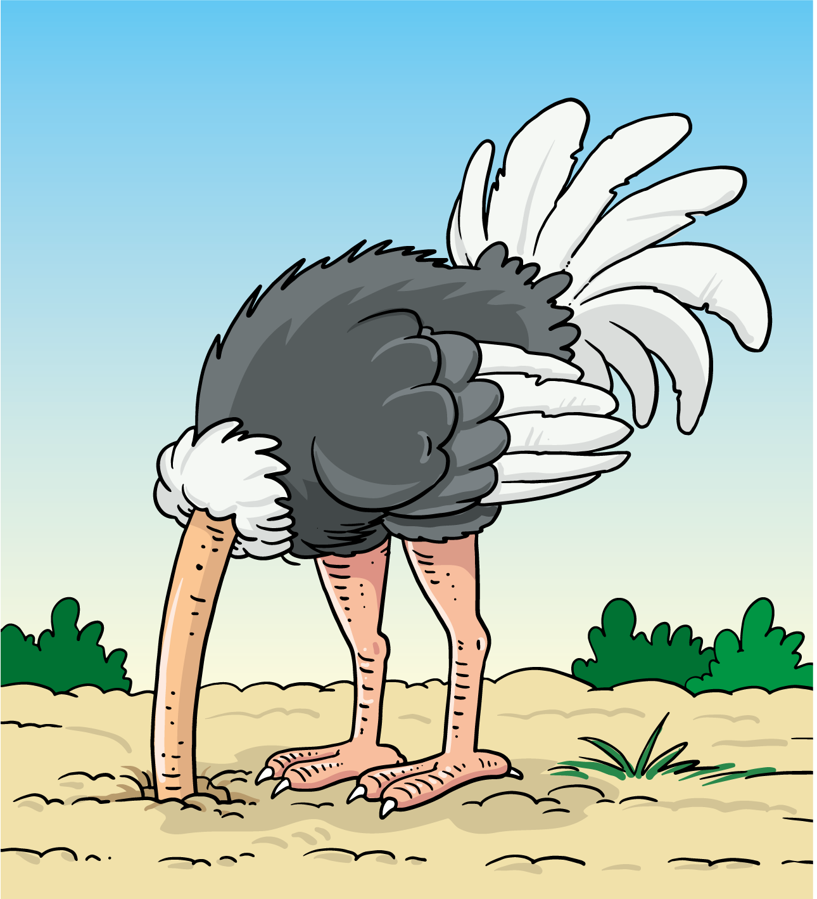
The bachelor report is extremely important
Together with your oral presentation at the exam, the bachelor report is the only thing that censor sees and evaluates
Hence, you should be sure to have plenty of time to write a good report
To have sufficient time, you may need to skip part of your data collection, restrict your experiments, make a simplified implementation/prototype or develop less theory/proofs
It can be very hard to give up parts of your project
But not doing it may turn out to be catastrophic
Be timely: one or two weeks before the final deadline is far too late
Use your bachelor project contract to measure your progress
Don't be an ostrich
Waiting and hoping for a miracle is a dangerous strategy

Slide 5
You need to write things down
The production of the bachelor report should start immediately
When you read literature, write working notes about the papers you study
When you make experiments and write programs/prototypes, make section drafts describing your efforts – remember to include arguments for major choices/decisions)
When you formulate definitions, lemmas and theorems, make them as clear and comprehensive as possible (this includes the proofs)
The importance of written notes cannot be overestimated
Our memory is extremely limited
Make written notes of all ideas, decisions, insights, etc.
In a few minutes, many of them will be forgotten – or it will take considerable time to reconstruct them
Other ways to remember things
If you have a whiteboard full of ideas, take a photo
If you are walking or biking, send an sms or voice message to yourself
If you wake up in the middle of the night and have a bright idea, write a few words on a piece of paper so that you can investigate further next day

Slide 6

Finishing your report
When you have finished your experiments / programming / theoretical work, everything should be documented in working notes and section drafts
Then it is "easy" to finish the report
Write the missing parts (abstract, introduction, comparison to other approaches, ideas for future work, conclusions, acknowledgements, etc.)
Put the working notes and drafts together to form the report and make things consistent
Proof read to find logical and grammatical errors
Plan at least 90 hours to finish the report
Three weeks of 30 hours or two weeks of 45 hours
If you do not have adequate drafts and working notes, you will need much more time for this part
Less than 2 weeks is a NO GO (unless you hope for a miracle)

Slide 7
Typical table of contents
Initial part (2-5 pages)
Abstract (summary)
Introduction
Central part (approx. 20 pages)
Review of literature (may also be part of the introduction)
Description of your experiments, programming, prototyping, theories, proofs etc.
Description of your analysis and results
Final part (5-10 pages)
Summary of your results, comparison to other work, and ideas for future work
Conclusions / perspectives / contextualisation
Acknowledgements
References
Appendix with programming code, tables, full proofs, etc. (5-20 pages)
It must be possible to read and understand your report without reading the appendix
Critical things must be in the main part of your report
The appendix is for readers who want to study additional details
Censor will probably only take a quick glance at the appendix
Figures, program code, etc. should be in a size which is readable for ordinary people – without magnifying glass
3
2
1
1
1
2
3
3
1
1

Slide 8
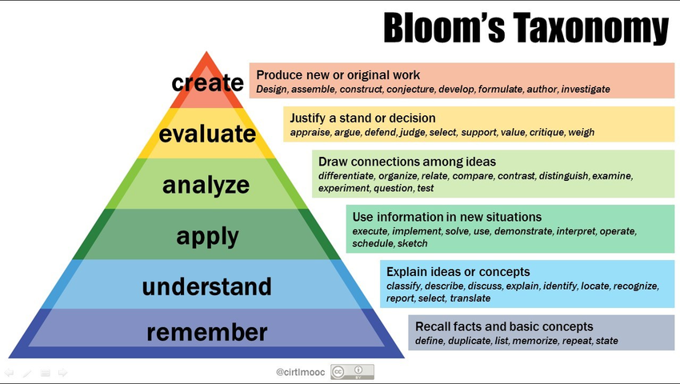
Bloom's taxonomy for læringsmål

Slide 9






Academic paper "reverses" the taxonomy
Let us for a moment ignore Abstract and Conclusion
Introduction
Review of literature
Do not write you report as a crime novel revealing the exciting stuff at the very end
Describe your results in the abstract (summary) and in the introduction
Put the details of your results as early as possible in the main part
Repeat the results in the conclusion
Experiments
Programming
Results
Comparison to other work
Perspectives / Contextualisation
"Exceptional" results

Slide 10
Front page
The front page of your report must contain
Danish title and English title
Names and study numbers (studienumre) for all participants in the group
Name of advisor(s)
The following three lines (in Danish or English)
Bachelor report (15 ECTS) in Computer Science [or IT product development]
Department of Computer Science, Aarhus University
June XX, 20XX
You may insert a nice, illustrative figure from your report as a kind of logo

Slide 11
Title for the bachelor project
It is important to choose a good, informative title for your report
When searching for literature, many potential readers only see your title (and the names of the authors)
Based on the title, they decide whether they want to read the abstract
Based on that, they decide whether to read the introduction / summary, and so on
If the title does not catch their attention, they will never see your brilliant work
The title should describe the content of your work as precisely as possible without being extremely long
Some authors like to make a catchy or fun title
This is seldom a good idea (because information of the contents may be lost)
For your bachelor project, there must be both a Danish and an English title
To avoid confusion, they should be identical (straightforward translations of each other)
The Danish title (or part of it) may be identical to the English title
The titles will appear on your diploma (eksamensbevis)

Slide 12
The initial part of your report contains
Abstract (summary)
Short summary of
topic and central issues
approach and theory
main results
Should be comprehensible without reading the rest of the paper
If you write in Danish, there must be both a Danish and an English abstract (summary) with the same content
To avoid confusion, they should be identical (straightforward translations of each other)
Introduction
Introduce the subject area and the "gap" addressed in your work
Describe your
starting point (work by other persons)
the results you obtained
the limitations of your work

Slide 13
The central part of your report contains
Related work (may also be part of introduction)
Work that you build upon or take inspiration from
Clearly show how your work contributes / extends / differs
Theories, methods and techniques to be used
Theorems, data collection techniques, prototyping, programming techniques, analysis techniques, use of test persons, etc.
Experiments and development by you
Collection of data, construction of prototypes, new theorems, new proofs, etc.
Analysis and results
The findings that your work supports
Detailed arguments, logical reasoning

Slide 14
The final part of your report contains
Conclusion
Similar to abstract but now with more details and arguments
topic and central issues,
approach and theory,
main results
Should be comprehensible after reading the introduction (or by someone who knows the subject area well) – to make a full judgement of the validity, the entire report must be read
Also describe
interesting future work,
possible impact of your work – on theory / practice / life conditions,
possible use in other areas (broader perspective)
References
List of the papers you have read during the bachelor project
Appendix
The appendix is for readers who want to study "all details", e.g. to be able to reproduce your experiments, apply your prototypes, check your proofs, etc.
Censor will probably only take a quick glance at the appendix
It must be possible to read and understand your report without reading the appendix
Critical things must be in the main part of your report

Slide 15
References
We use references to
indicate that we are familiar with and have surveyed the topic
give credit where credit is due
indicate a source, specific position and/or related argument
support/warrant arguments and claims
Always cite sources, always
Failing to cite a source may be seen as an attempt to plagiarize the work of others
This may have serious consequences
More information about plagiarism http://library.au.dk/en/students/plagiarism/ Link
Always read the papers you reference
Format of citations
Use BibTeX, EndNote (or similar systems) and manage references as you find the papers
Try to get the citation from the original source (check for accuracy if copy-pasting from Google Scholar)
Use number or name+year, e.g., [12] or (Jensen 2007)
Include page number for quotes, e.g. [12, p. 23] or (Jensen 2007, p. 23)
The reference list can be sorted alphabetically (by the surname of the first author) or by the order in which the references appear in the text (first time)
Ask your supervisor for advice

Slide 16

Your contributions must be clear
It is a very common error to be vague about the origin of things
It is obvious for you, what you have done – but the reader must also be told
For everything that you describe, it must be crystal clear for the reader whether this is the work of other researchers or your own work
"XX introduced…" versus "We introduced…"
Check this for all parts of your report
Compare to the work of other researchers
How does your work differ from others'?
How do your results differ from earlier results?
How did you use the work of other researchers?
What are your main contributions?
Before writing the abstract and the conclusion list the most important contributions / findings from your bachelor project (2-5 things)
Be sure to present these in the abstract and in the conclusion – in such a way that it is crystal clear how you contributed
Later, you should do the same in the oral presentation at the exam

Slide 17
Language and grammar
Forget what you learned from your Danish teacher in high-school
When writing an essay, you were probably told to vary your language as much as possible – using synonyms and different construction of sentences
Try to be as consistent as possible
In science, we define a concept and name it. Then we use that name whenever we talk about that concept
The descriptions of two or more similar things should be as identical as possible, so that it is clear which differences are intended (not accidental)
Simplify the language and structure
Use short sentences
With little effort you can often simplify a sentence and improve the readability
Example
If you describe two or more similar things, the descriptions should be as identical…
The descriptions of two or more similar things should be as identical…
Your responsibility
It is your responsibility to make the text easy to understand, with clear arguments and few chances of misconception
A good template, basic structure and spellcheck can do a lot for readability

Slide 18
Language and grammar (continued)
A few grammatical errors are ok
Too many grammatical errors will make the reading difficult and distract the reader from the subject matter
The threshold (for distraction) differs a lot from person to person
Translations
A lot of Danish phrases cannot be directly translated to English – check in an on-line dictionary (not "word book")
In Danish, many words are concatenated: "juletræspynt"
In English, you seldom do this: "Christmas tree decorations"
Construction of sentences and punctuation is different in English (consider getting help to check this in the final proof reading)
Different kinds of English
British English ≠ US English (analyse and modelling / analyze and modeling) Link
You have to decide which one you use – ask your advisor
Typo's
Remember splelchekc (British English ≠ US English)
Special problems, e.g. dyslexia (Danish: ordblindhed)
Tell your advisor as early as possible / consider whether you need special help

Slide 19
Make tables and graphs as clear as possible
Tables
Make headings as descriptive as possible
We usually read from left to write
Help the user as much as possible
Remove unnecessary columns and rows
You will also need good figures for your oral presentation
Make them early enough to put them in your report
A | B
13.6 | 5
24.7 | 10
31.7 | 15
Temp Cº | Time mins
13.6 | 5
24.7 | 10
31.7 | 15
Time mins | Temp Cº
5 | 13.6
10 | 24.7
15 | 31.7
Time mins | Temp Cº | Temp inc Cº/min
5 | 13.6 | 2.72
10 | 24.7 | 2.47
15 | 31.7 | 2.11
Time mins | Temp inc Cº/min
5 | 2.72
10 | 2.47
15 | 2.11
A = minutes used
B = temperature
Graphs
Place text close to nodes/arcs (or inside nodes)
Be careful with arrow heads, positions, directions and with forks/joins
Help the user as much as possible
Much more information in the lecture by Hans-Jörg Schulz
A
Athens
A
C
A
D
C
D
C
B
Chicago
Beirut
B
D
Dayton
B

Slide 20
Proof reading
Divide and focus your checks
In one round, you focus primarily on grammatical errors
In one round, you focus om simplification of the text (short sentences etc.)
In one round, you check that you use the terminology, you have introduced
In one round, you check all your proofs
In one round, you check the layout of your paper, e.g. whether the tables and figures are positioned in such a way that you can see them, while you read the explanation of them
In one round, you check all your tables and figures
In one round, you check that all section headings are consistent
In one round, you check all your references
In one round, you focus on punctuation (commas and full stops)
………
Proofread your drafts before you submit them to your advisor
The quality of your text will influence the quality of the comments you get back
If your draft is well-formulated with a clear logical structure without too many loose ends, it is much easier for your advisor to understand your ideas and make good proposals for improvements
The higher quality you have in your drafts, the easier it will be to put things together at the very end

Slide 21
Proof reading (continued)
Enlist the help of other people
Ask other students to read part of your text – perhaps you can make a deal with another group working on a similar topic
Ask boyfriends / girlfriends and your mother to look for grammatical errors and clumsy language – and ask all kinds of "stupid” questions, which can help you clarify your text
Some “tricks”
Use the facilities in LaTeX / Word to automate things (styles, references, table of contents, references to figures, other sections etc.)
Make as many automatic checks as possible (it is easy to search for two adjacent spaces and replace them by one; analogously you can search for two adjacent full stops, two commas, or a space followed by a full stop)
For many people, it is fruitful to read the text out loud
Do not make your proofreading when you are too tired to do other things
Pause

Slide 22
Bachelor report ←→ Learning goals
Bachelor report
Abstract
Introduction
Related work
Theories, methods and techniques
Experiments and development
Analysis and results
Conclusion
References
Learning goals: After the course you will be able to
formulate a cs/it academic problem based on relevant literature [1,2,3,8]
implement a written assignment during the use of cs/it academic methods [4,5,6]
apply cs/it theories and methods to an academic problem [4,5,6]
analyse a cs/it academic problem using relevant literature [3,6,8]
discuss and put in perspective a cs/it academic problem [6,7]

Slide 23
Writing process
It is extremely important to work in an iterative way
Don't throw out existing text – revise and improve it
Keep notes about things which must be included / modified – but finish your present task before making the additions /changes (don't work like a stack)
Don't be afraid of writing too much in the early phases – it is easy to throw things away
Writing is also thinking
We get new insight when we write
Simplifying a description may make it possible to see new patterns, which may lead to new simplifications revealing new patterns leading to further simplifications, etc.
Use each other
When one of you has written the first draft of a text, it may be fruitful to let another group member revise it – improving / deleting things which are unclear / invalid
If you get stuck, ask another group member for help / ideas
Finish each day by making a common plan for the next
If you work alone and get stuck: do something else, and return a few hours/days later
You can write in a similar way as you program
Programming: design & analyse → implement → test & debug
Writing: outline → write → review
Write "section stubs" where you only outline the contents

Slide 24
Use of comments and critique
In your bachelor project you will work intensively with a given subject
Hopefully, you will take ownership of your work
It will be your "baby"
In such a situation, it is very natural to be "defensive" towards critique and proposals for changes
This is, however, very stupid
Your advisor (and other people who look at your work) invests considerable time in making comments and proposals for improvements
They are not made to annoy you – but to help you to improve your project and hence your report (and your final grade)

Slide 25
Example
When reading a draft of one of the sections in your bachelor report, your advisor misunderstands one of your arguments
The straightforward / natural approach is the following
You can see that this is because the advisor does not know your work well enough, or has read the corresponding paragraph too fast
Hence, you tell this to your advisor, and do not change anything in your report
The comment has not helped you to improve your report
A much more fruitful approach is the following
A lot of your readers – including the censor – will be in the same situation as your advisor (not knowing your work in detail, and reading parts of your report very fast)
Hence, you should use the “stupid" comment made by your advisor to thoroughly investigate whether you can reformulate the paragraph in such a way that it becomes less likely that a "stupid, too fast" reader may misunderstand your text
It is your responsibility that your text is as clear and unambiguous as possible
Using this approach, you have improved your report
By using all comments and proposals in a constructive way, you can significantly improve the quality of your report

Slide 26
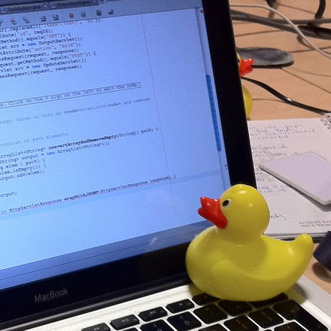
When you are stuck
Taking a break often helps
Take a run
Go for a walk
Get some sleep
Get coffee / food
Chat with some friends
Relaxing in some way is the catalyst for many great ideas
They must be written down as soon as possible
Otherwise, most of them will be forgotten
Still stuck?
Stop writing and review other sections
Explain what you are trying to write to another group member (or a rubber duck)!
Try writing it as an email to your advisor (perhaps never send it)
Take some time off

Slide 27
Things to do and not to do
Do
Write! You need lots of draft text to turn into finished text
Sketch tables and figures on paper and put them in ASAP
Insert references (in BibTeX or EndNote) when you find the papers
If something reads odd or you don’t fully understand it, change it
When you think the structure doesn't work; clone section/document and try another structure
Don't
Expect others to take charge and polish
Introduce too many ideas at the same time
Introduce new stuff in the conclusion
Do references and layout the night before the deadline
Use a lot of different fonts and styles
Be honest about your work
Build on what you have and know — all of it
Identify the strengths and point them out
Identify the weaknesses and address them in the discussion

Slide 28

Summary: Important pieces of advice
Make it very clear whether things are your contributions or others'
Write everything down before you forget
Have enough time to finish the report – language and grammar do count
Do not postpone all proofreading to the end; your drafts should also be readable
Use the comments given to you – people want to help, not annoy you
Do not make postulates – detailed arguments are needed
Two or three good results are better than 10 vague
Do not keep the reader in suspense – describe your main results early
Don't cheat – even with small things – remember to reference
Do not write an essay – you are making an academic paper
Simplify, simplify and simplify (language, tables, figures, structure, …)
Help your reader as much as possible – with arguments, calculations, etc.
Remember breaks – one efficient hour is better than two “slow” hours
Remember that you are a group – use your different competencies
Use your friends, family, other students, …
Remember backup; keep old versions in a systematic way

Slide 29
● Part 2: How to make an oral presentation?
Making a good oral presentation is difficult
It requires a lot of preparation
It can be learned (if you invest the necessary time and energy)
The first time is the most difficult one
Gradually, you will develop your own presentation style (suitable for your research / work area)
Many of the guidelines given for the written report also apply to oral presentations
As an example, it is very important be crystal clear whether this is the work of other researchers or your own work
Provide arguments – not postulates
Use the correct terminology
Try to be as precise and consistent as possible without unnecessary repetitions
Do not put things on your slides that you are not prepared to explain

Slide 30
Formal requirements for the oral presentation
Oral exam in June
The report is the basis for an individual 30 minutes' oral exam, where you present the findings of your bachelor project followed by a discussion
A common grade is given for the written report and the oral exam
An external examiner (censor) participates in the evaluation of the report and the oral exam
You get information about the date, time and place of the examination from your advisor
Language
Your presentation and your slides may be in Danish or English – use the same language for both
Using the same language as your report has some obvious advantages
Check with your advisor whether the censor is able to understand Danish
Re-examination
If you do not pass, it is possible to resubmit a revised version of the report no later than August 15

Slide 31
Contents and duration
At the oral presentation of your bachelor project, we expect you to
present the most important concepts within the area/project you have been working with
present the most important results of your work
be able to answer detailed questions about your work
Duration
Your presentation should last approximately 15 minutes
The rest of the time is used for questions and discussion
Bachelor groups
Each student makes an individual presentation
Discuss with your advisor, whether each presentation should give an overview of the entire project or the individual students in the group should focus on different parts / aspects

Slide 32
General advice
It should be possible to understand your talk without knowing the details of your report – but you can assume a general knowledge of the area
Start the talk by giving an outline of your talk – and the motivation for your work
It is better to concentrate on the most important results of your work than trying to cover a lot of different minor results
Do not drown in details – remember to give the context, overviews and conclusions
Provide arguments – not postulates
Try to be as precise and consistent as possible without unnecessary repetitions
Use the correct terminology
To save time, it may be useful to simplify some examples / figures / tables from the report – removing things which you do not need for the oral presentation
Be realistic about how much you can cover – it gives a bad impression to have a large number of slides which you are unable to cover within your 15 minutes
It is extremely important that it is crystal clear what is your work and what is the work of other people
Remember references to the work of other people
Do not make excuses
If something is inappropriate you should change it before the presentation

Slide 33
Contents of your slides
There are no rules about the number of slides and how detailed they are
But you do not get much credit for things which you read up directly from your slides
Hence the slides should not be too detailed – but they should help you to remember the most important details and to save time when you need to present complex things
You can e.g. have some program code on the slide, which you explain orally during your presentation – or you can have a complex figure / table / graph which you explain
Detailed references to papers can also go on your slides
Put only things on your slides which
are needed for your presentation
you are prepared to answer detailed questions about
Put page numbers on your slides (then it is easier for the examiner/censor to refer to them)
Do not
Read the text directly from your slides – use your own words
Put large pieces of text on the slides in a small font (unless it is clear that you do not intend people to read it)
Proof read your slides thoroughly – both for linguistic and logical errors
Ask other people to help with the proof reading
Some advisors are willing to give feedback on your slides before the exam

Slide 34
Use of other media
You are of course also allowed to use the whiteboard
But this may use a considerable amount of your time and it is easy to make errors
If you want to use the whiteboard practise this carefully (and bring your own pens)
You may also use photos or short videos
This may sometimes be a good idea
But consider whether it really helps you (and your audience) or only acts as a nice gimmick (taking up valuable time)
For videos you should thoroughly test that they start and display as intended (on the computer to be used for the presentation)
Live demo of software prototypes
You may also want to demonstrate a software prototype developed in your project
Carefully consider how much time you want to use for it
Practise it thoroughly on the correct computer – it is very easy to waste a lot of time on technical difficulties without any real gain for your presentation
Sometimes such presentations can be done prior to the exam – ask your advisor

Slide 35
You need a lot of practise
With practise you will be able to describe your work much more precisely and much faster
This means that you can cover more results and be more clear/understandable
Before the exam you should make you presentation at least 10 times
The practise should be as realistic as possible
It is not enough to think what you want to say
You need to formulate the exact sentences – and mumble / say them loud
During the practise you should also modify your slides – so that they are optimal for your oral presentation
If you want to use the whiteboard, videos or live demos this must be practised too
Get help from other students
Make your presentation for other students and listen thoroughly to the feedback they give you
If you are in a bachelor group you are allowed to help each other – but avoid getting too identical presentations

Slide 36
More advice…
Use a watch to check the duration of your talk while you practise
You should be able to finish it within 15 minutes
Do not hope for a miracle – it will not happen
Repeat the first 1-2 minutes of the talk so many times that you are absolutely sure what to say – and how to say it
When you are nervous it is easy to be confused and to forget even simple things
Hence, it is very important to get a good start
Do not improvise during the talk
Do not invent new ideas and new examples during the talk
Stick to your slides and the planned content of your talk
Be honest about your work
Identify the strengths and point them out
Identify the weaknesses and address them
Try to guess what the examiner and censor may ask you about
Prepare what your answer will be
If you do not understand a question – ask for clarification (instead of guessing)
Be forthcoming and courteous

Slide 37

More advice… (continued)
One of the most efficient ways to improve your performance is to hear the presentation of other students (to learn from their good/bad things)
Hence, we strongly encourage you to attend the presentation of other students
Please note that you are not allowed to attend the exam of other members of your own bachelor project group prior to your own exam
Do not work until the last minute
Take some time off the day before your presentation
Go for a walk or a run or do some other kind of exercise – physical activity decreases your stress level and make you tired so that you can get a good nights sleep
There is no need to be nervous
If you have prepared a good slide set and made your presentation at least 10 times things cannot go totally wrong

Slide 38
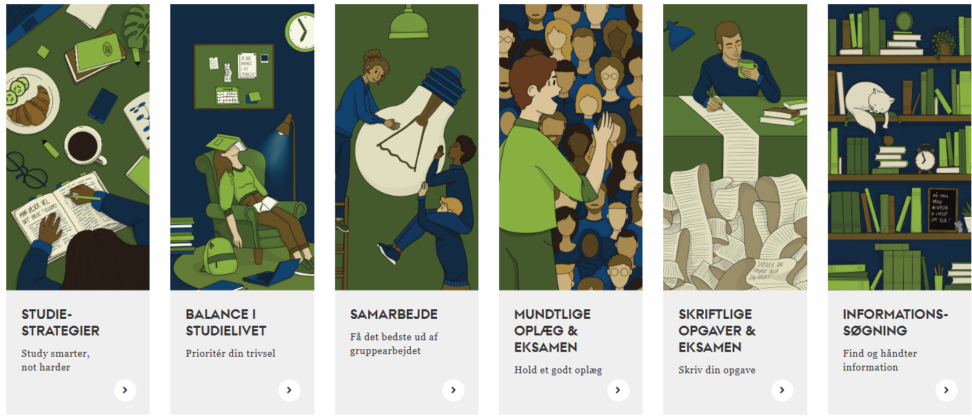
AU Studypedia (studypedia.au.dk)
A set of webpages which offers advice, inspiration and exercises in a number of different study related areas
There is both a Danish and an English version
Very extensive and useful material
Use some hours to study it
Alone or together with your bachelor group
There is also a set of advice to cope with nervousness

Slide 39
That's all for now… … questions

